Slide 1

Marianne M. Jennings
Business
Its Legal, Ethical, and Global Environment
10th Ed.
Chapter 19 Governance and Regulation: Securities Law

Slide 2
History of Securities Law
Initially Regulated at the State Level
1929 Stock Market Crash Precipitated Federal Regulation

Slide 3
1933 Securities Act
Primary Offerings
A primary offering, or an initial public offering (IPO), is a sale of securities by the business itself
What is a Security?
Investment in a common enterprise with profits to come from the efforts of another (SEC v. Howey)
Includes stocks, bonds, warrants, debentures, voting-trust certificates, oil wells, and so forth
Pension plans are not covered

Slide 4
1933 Securities Act
Securities and Exchange Commission
Administrative Agency responsible for regulating the sale of securities under both the 1933 and 1934 Acts

Slide 5
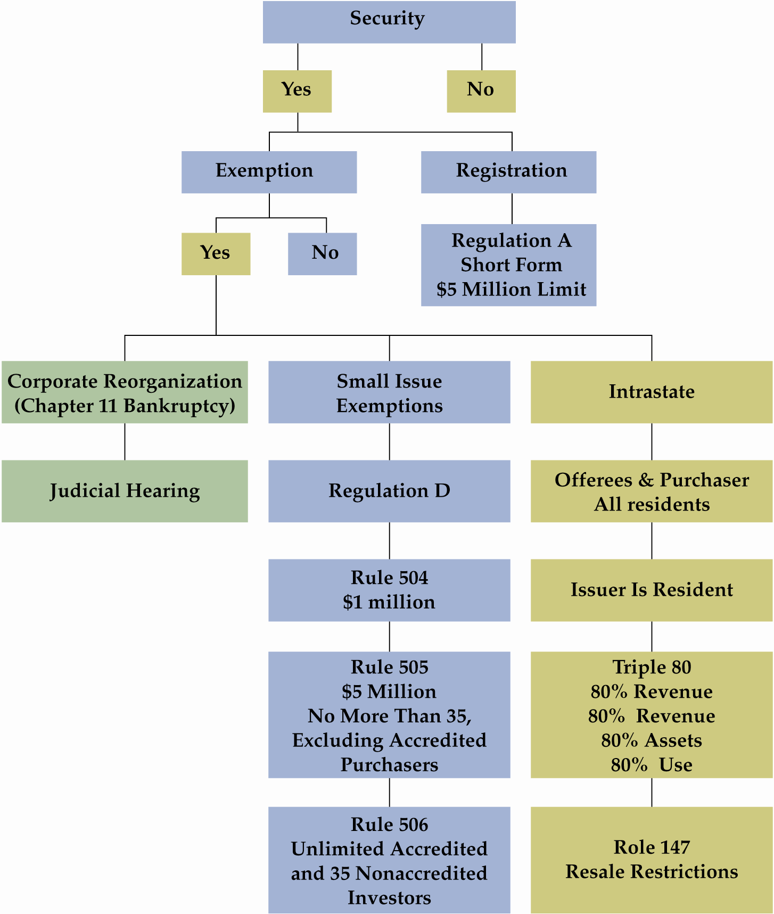
1933 Act: Exempt Transactions

Slide 6
1933 Act: Exempt Transactions
Exempt Securities
Securities issued by federal, state, county, or municipal governments
Commercial paper (less than nine months)
Banks, savings and loans, religious and charitable organization securities
Insurance Policies
Annuities
Common Carriers (ICC Regulates)
Stock Dividends and Splits

Slide 7
1933 Securities Act Transaction Exemptions
See Exhibit 19.1, p. 630

Slide 8
1933 Act: Exempt Transactions
Intrastate Offerings - Rule 147
Issuer must be domestic business in state where offering is made
Offerees must all be residents of the state
Triple 80 requirements
Transfer restrictions apply

Slide 9
1933 Act: Exempt Transactions
Reg A Offering
Shortcut method of registration
Applies to $5 million ($7.5 JOBS expansion) or less during a 12 month period

Slide 10
1933 Act: Exempt Transactions
Reg D Offerings to “Accredited Investors”
Bank
Private Business Development Co
Director, Officer of Issuer
Natural persons with net worth >$1million
Natural persons with annual income of $200,000-300,000 /year
Dodd-Frank continues to make changes

Slide 11
1933 Act: Exempt Transactions
Reg D Offerings
504 : $1million or less during 12 months (up to $2,000,0000 under JOBS)
505: up to $5 million with less than 35 unaccredited investors (up to $7.5 million under JOBS)
506: no dollar cap, no limit on accredited investors, unaccredited less than 35

Slide 12
1933 Securities Act
What Must Be Filed—Documents and Information for Registration
Materials include
Description of securities
Audited financial statement
List of assets
Nature of business
List of management and their shares

Slide 13
1933 Securities Act
What Must Be Filed—Documents and Information for Registration
Before registration statement is effective
Can run tombstone ad
Can issue red herring (sample prospectus)
Cannot make offers to sell

Slide 14
1933 Securities Act
Violations of 1933 Act
Section 11 Violations
Civil liability for inaccurate information in registration statement
What is required for a violation?
Failure to make full disclosure
Registration statement contains a material misstatement or omission

Slide 15
1933 Securities Act
Violations of 1933 Act
Who is liable for a violation?
Officers
Directors
Anyone who signed registration statement
Experts (lawyers, accountants, appraisers, geologists)

Slide 16
1933 Securities Act
Violations of 1933 Act
Defenses for Section 11 violations
Immaterial misstatement
Investor knew of misstatement and bought anyway
Due diligence—acted with prudence and had no reason to believe there was a problem - not available to issuer

Slide 17
1933 Securities Act
Due Diligence and Sarbanes-Oxley
Registration with Public Company Accounting Oversight Board
Auditor Independence
Eliminates conflict of interest
Prohibits e.g., bookkeeping, actuarial services, internal audits, legal audits

Slide 18
PCAOB
Consists of Five Presidential Appointees
Nonprofit Organization
No More Than Two Members Who are CPAs
Will Develop Registration System for Public Accounting Firms
Establish Rules to Ensure Quality, Ethics and Auditor Independence
Will Inspect Firms to Determine Compliance With Sarbanes-Oxley
Will Investigation Violations and Impose Discipline
Will Encourage High Standard in the Accounting Profession
Dodd-Frank expands PCAOB’s authority to regulating analysts

Slide 19
SOX Auditor Conflicts
Bookkeeping
Information Systems
Appraisals
Actuarial Services
Management or Human Resources Services
Broker, Dealer Services
Legal Services
Expert Services
Other as PCAOB Dictates

Slide 20
Due Diligence
Case 19.1 Escott v. BarChris Construction Corp. (1968)
Did BarChris disclose all its debts?
Were all of the misstatements or omissions material?
Who was held liable?

Slide 21
Violations of 1933 Act
Penalties
$10,000 and/or five years
Injunctions to stop sales
Civil suits
Securities Litigation Reform Act of 1995
Limits attorneys’ fees
Addresses “professional plaintiff”
Allows “safe harbor” protection for financial predictions

Slide 22
Violations of 1933 Act
Section 12 Violations
Selling without registration (unless exempt)
Selling before the effective date
False information in the prospectus-same penalties as Section 11

Slide 23
1934 Securities Act
Regulates Secondary Market
The 1934 act regulates securities and their issuers once they are on the market
Securities Registration
All traded securities on exchanges must be registered
All securities of firms with over $10 million in assets and 500 or more shareholders must be registered

Slide 24
1934 Securities Act
Periodic Filing
Same firms—national stock exchange and/or 500 or more shareholders and $10 million or more in assets
10-Q—quarterly financial report
10-K—annual report
8-K—unusual events, spin-offs

Slide 25
1934 Securities Act
The Anti-Fraud Provision 10(b) and Regulation 10(b)-5
Fraud or misrepresentation in the sale of securities
Applies to all firms (only requires interstate commerce)

Slide 26
1934 Securities Act
The Anti-Fraud Provision 10(b) and Regulation 10(b)-5
Failure to give information or giving overly pessimistic information results in violation
Examples: Failure to disclose pending merger—Texas Gulf Sulphur’s failure to disclose a rich mineral strike

Slide 27
1934 Securities Act
The Anti-Fraud Provision 10(b) and Regulation 10(b)-5
What should be disclosed?
Pending takeovers
Drops in quarterly earnings
Pending large dividend
Possible lawsuits
When to disclose?
Once information becomes public knowledge, insiders and tippees are free to buy and sell the affected shares

Slide 28
1934 Securities Act
Case 19.2 Siracusano v. Matrixx Initiatives, Inc. (2011)
What does the Court say the misappropriation theory is?
Could others have done research and obtained the same information?

Slide 29
1934 Securities Act
Insiders, tippees are all responsible under 10(b)
Case 19.3 United States v. O’Hagan (1997)
How did the lawyer come to possess the information?
Is there something about a duty beyond being the actual lawyer for the client?

Slide 30
1934 Securities Act
How Soon Can You Trade After Corporate Disclosures?
Must allow information to go public
Texas Gulf Sulphur case and adequate disclosure

Slide 31
1934 Act: Aiders and Abettors
Stoneridge decision was troublesome to investors and regulators
Third parties joined with the company to dupe the auditors about the company’s true financial picture
Dodd-Frank changes their immunity under 10b; they can be liable for knowing participation in dissemination of false information

Slide 32
1934 Securities Act
The Anti-Fraud Provision 10(b) and Regulation 10(b)-5
Standing to sue: must have been an actual sale or purchaser to sue
Mental state: need scienter – the intent to defraud
Penalties include $100,000 and up to five years per violation

Slide 33
Section 16 – Short Swing Profits
May 1, 2013 Director A buys 100 shares at $10 each
June 1, 2013 Director A sells 100 shares at $6 each
July 1, 2013 Director A buys 100 shares at $4 each
Profit of $200
Highest sale $600
Lowest purchase $400

Slide 34
1934 Securities Act
Section 16—Insider Trading and Short Swing Profits
Applies to officers, directors, and 10 percent shareholders
Liable to corporations for profits made on sales and purchase or purchases and sales during any six month period
SEC matches highest sale with the lowest purchase

Slide 35
1934 Securities Act
Section 14—Regulating Voting Information
Idea is to have full disclosure
Proxy materials must be registered with the SEC
Who is soliciting
How the materials will be sent
Who is paying

Slide 36
1934 Securities Act
Section 14—Regulation of Voting Materials
Proxy materials must be registered with the SEC
How much has and will be spent
Purpose of proxy—an annual meeting
Shareholder proposal
Management must include under Dodd-Frank if subject matter is appropriate
Can get list for solicitation, but management now absorbs the expense so this is less likely

Slide 37
1934 Securities Act
Section 14—Regulation of Proxy Materials
Shareholders and executive compensation
Shareholders have right to advisory vote every three years
Compensation committees are now comprised of independent directors
Remedies for Section 14 violations
Invalidate proxies
Invalidate actions at meeting

Slide 38
Shareholder Rights
Merger: a combination of two or more corporations in which only one of the original corporations continues to exist
Consolidation: a combination of two or more corporation into a new corporation

Slide 39
Mergers and Consolidations

Slide 40
Shareholder Rights
Tender Offer: A Public Offer to Shareholders of a Company to Purchase Their Shares
Takeovers: Obtaining Control of Company Through Use of Tender Offer – May Be Either Friendly or Hostile
Acquisitions: Purchase of Asset (Not Stock) of Another Company

Slide 41
Shareholder Rights
Williams Act Requires Registration of Tender Offer Statement
Shareholders Have 7 Days To Withdraw Shares

Slide 42
Shareholder Rights
State Laws Affecting Tender Offers
Focuses on corporate governance such as dissenters’ rights
The Future for State Antitakeover Statutes
New state laws requires extended waiting period to takeover company without consent of target company Board of Directors

Slide 43
Shareholder Rights
Proxy Regulations and Tender Offers
Proxy solicitation is also governed by SEC
Proxy solicitation must be registered with SEC

Slide 44
State and Federal Securities Laws
1933 Act
S1 – Registration statement
Financial information
Officers/directors
Prospectus
20-day effective date, deficiency letter
Section 11 – Filing False Registration Statement
Liability: Anyone named in prospectus or offering expert materials for it
Material, false statement; privity not required unless longer than one year
Defenses: due diligence; buyer’s knowledge

Slide 45
State and Federal Securities Laws
1933 Act
Section 12 – Failure to File; Selling Before Effective Date; False Prospectus
Material; false statement; privity required
Defenses: due diligence; buyer’s knowledge
Penalties
$10,000 and/or five years (criminal/civil suit

Slide 46
State and Federal Securities Laws
1934 Act
10b – Securities Fraud
Penalties - $1,000,000 and/or 25 years
Section 14
Proxy registration
Compensation disclosure
500 or more shareholders with $5 million or more in assets or listed on national exchange

Slide 47
State and Federal Securities Laws
1934 Act
8K – Regular reporting at time of event
10K – Annual reports
10Q – Quarterly report
Foreign Corrupt Practices Act
Financial reports
Internal controls
Applies to 1933 and 1934 act registrants
Section 16A
Officers, directors, 10% shareholders
Sales registration

Slide 48
State Securities Laws
Blue-Sky Laws
State registration requirements
Merit vs. disclosure standards
Federally exempt securities may still need to register at state level
Can Follow a Merit Review Standard
Securities reviewed for their merit must be “fair, just, and equitable”

Slide 49
International Securities Issues
Money Flows Freely Across Borders
United States has most stock exchanges
European Union has regulations on disclosure
Insider trading becoming more vigorously regulated in other countries
Only United States has proxy disclosures

